Slide 1
2020 하반기 설리번 프로젝트
스스로 만들어보는
지도 웹 어플리케이션
[2차시] HTML
설리번 프로젝트 Web2팀 l 윤새연 김민주

Slide 2

학습목표
다양한 태그에 대해서 이해하고 이를 적절하게 활용할 수 있다

Slide 3
1. 태그(Tag)
<u>hello world</u>
<u><strong>hello </strong>world</u>
Tag: HTML 문서를 이루는 문법적 표시
= HTML의 명령어

Slide 4
2. 기본 태그
간단한 자기소개글
This website is made to introduce myself.
My name is Kim Minju and I go to university now.
I am 22 years old now. Recently introductiong ones
mbti is good way to get familiar with that person. For this instroduction, I checked my mbti, and it was ISTP.
Some features of ISTP was too lazy, I believe that is true.
If you want to know more about me, plz check my other favorites categories.

Slide 5
2. 기본 태그
글씨 강조하기:
<strong>: 글씨 bold 처리
<u>: 밑줄
This website is made to introduce myself.
My name is <strong>Kim Minju</strong> and I go to university now.
I am 22 years old now. Recently introductiong ones
<u>mbti</u> is good way to get familiar with that person. For this instroduction, I checked my mbti, and it was ISTP.
Some features of ISTP was too lazy, I believe that is true.
If you want to know more about me, plz check my other favorites categories.

Slide 6
2. 기본 태그
제목(header): h1(가장 크고)~h6(가장 작음)
<h1>About me</h1>
This website is made to introduce myself.
My name is <strong>Kim Minju</strong> and I go to university now.
I am 22 years old now. Recently introductiong ones
<u>mbti</u> is good way to get familiar with that person. For this instroduction, I checked my mbti, and it was ISTP.
Some features of ISTP was too lazy, I believe that is true.
<br> If you want to know more about me, plz check my other favorites categories.

Slide 7
2. 기본 태그
줄바꾸기:
<br>: 단순한 줄바꾸기
<p>: 문단으로 묶어서 구분
<h1>About me</h1>
<p>This website is made to introduce myself.
My name is <strong>Kim Minju</strong> and I go to university now.
I am 22 years old now. <br> Recently introductiong ones
<u>mbti</u> is good way to get familiar with that person. For this instroduction, I checked my mbti, and it was ISTP.
Some features of ISTP was too lazy, I believe that is true. <br> If you want to know more about me, plz check my other favorites categories.</p>

Slide 8
2. 기본 태그
이미지 넣기:
<img=src “이미지 주소”>
<h1>About me</h1>
<p>This website is made to introduce myself.
My name is <strong>Kim Minju</strong> and I go to university now.
I am 22 years old now. <br> Recently introductiong ones
<u>mbti</u> is good way to get familiar with that person. For this instroduction, I checked my mbti, and it was ISTP.
Some features of ISTP was too lazy, I believe that is true.
<img src= "https://cdn.pixabay.com/photo/2018/05/26/12/41/cat-3431271_1280.jpg" width="70%">
<br> If you want to know more about me, plz check my other favorites categories.</p>

Slide 9
2. 기본 태그
목록 만들기:
<ul>: 순서 없는 목록(번호가 안붙음)
<ol>: 순서 있는 목록(번호가 붙음)
<li>: 리스트에 포함되는 각 항목
<ol>
<li>Artist</li>
<li>Movie</li>
<li>Food</li>
</ol>
<ul>
<li>Artist</li>
<li>Movie</li>
<li>Food</li>
</ul>
<ol>
<li>Artist</li>
<li>Movie</li>
<li>Food</li>
</ol>
<ul>
<li>Artist</li>
<li>Movie</li>
<li>Food</li>
</ul>

Slide 10
3. HTML 문서의 구조
웹페이지의 이름:
<title>
Utf-8 방식:
<meta charset=“utf-8”>
문서에 대한 정보:
<head>
문서 본문:
<body>
HTML:
<!doctype html>

Slide 11
4. 웹페이지 리스트 완성하기
링크 걸기:
<a href=“00.html”></a>
a는 anchor / href는 hypertext reference
<body>
<h1><a href="me.html">About me</a></h1>
<ol>
<li><a href="fv1.html">Artist</a></li>
<li><a href="fv2.html">Movie</a></li>
<li><a href="fv3.html">Food</a></li>
</ol>

Slide 12
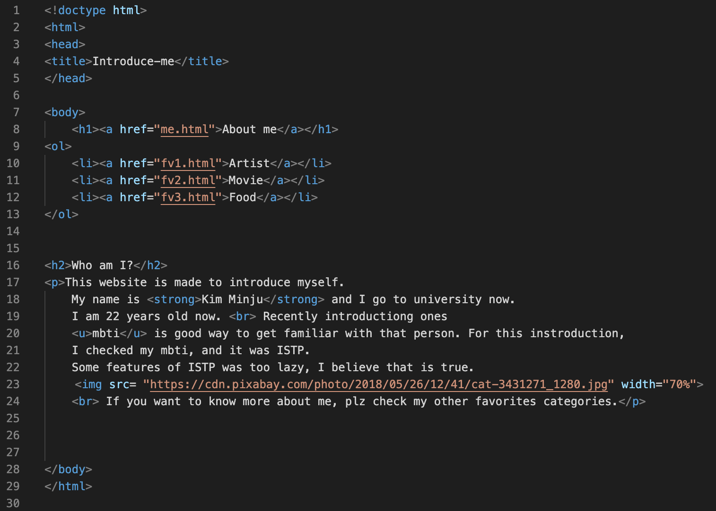
4. 웹페이지 리스트 완성하기

Slide 13
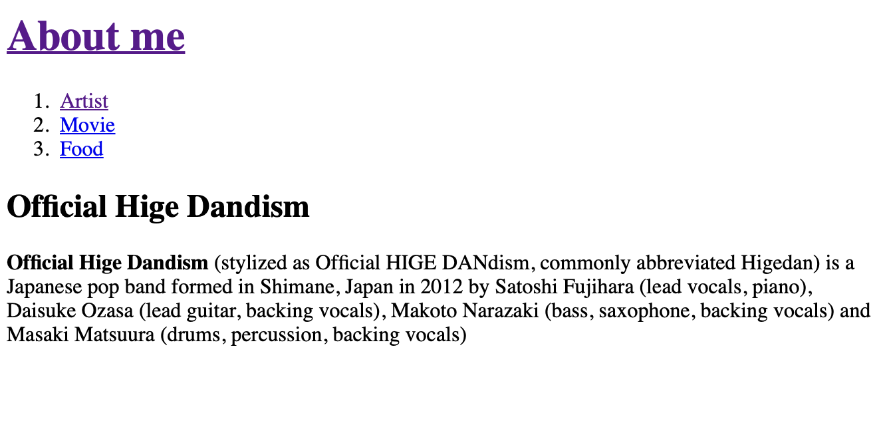
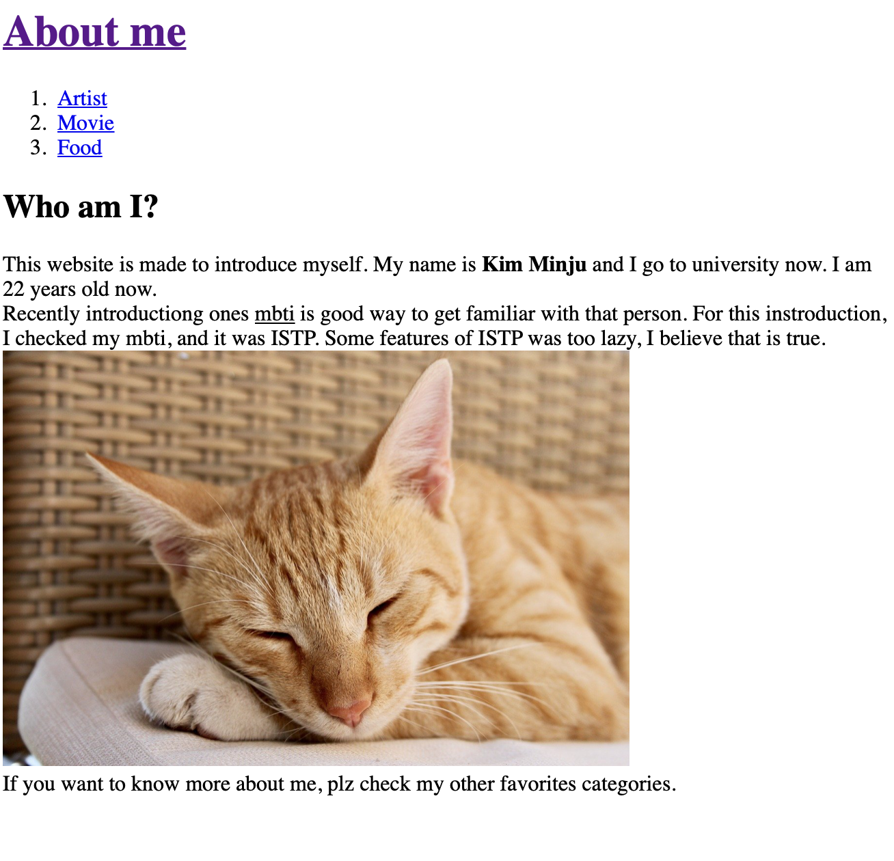
4. 웹페이지 리스트 완성하기

Slide 14
2차시 과제
리스트를 완성하기 !

Slide 15
다음 시간에 만나요!
▶︎ [3차시] CSS

